Slide 1



Campus connect
A centralized college Database Management System

Slide 2



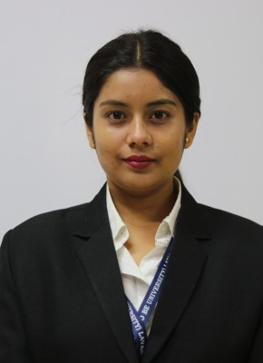


PRESENTED BY
"We will present on the benefits and implementation strategies of centralized database management systems to improve organizational efficiency and data accessibility."
SWATI KUMARI
22121001
ANSHU SINGH
22121104

Slide 3

Agenda
"Data is a precious thing and will last longer than the systems themselves." - Tim Berners-Lee
1 Introduction
2
Useful Functions
3
Problem Statements
4 Interpretations and Analysis

Slide 4

1
INTRODUCTION
GOAL
ATTRIBUTES ENTITITIES

Slide 5

GOAL
The goal of a centralized database management system is to provide efficient and secure access to data across an organization or enterprise.

Slide 6
Attributes
Attributes
College
Department
student
Faculty
Attendance
Back to Agenda

Slide 7
Attributes
Attributes
Course
Assignment
Library
Worker
Cantene
Campus store
Back to Agenda

Slide 8
1
FUNCTIONS

Slide 9




Briefly elaborate on what you want to discuss.
Functions
Join
Order by, Group by
Select, where, Aggregate
Back to Agenda

Slide 10
fi
PROBLEM
STATEMENTS

Slide 11

Retrieve the list of all colleges along with their grades and locations.
Display the name and email of all students in a specific department.
Get the list of all faculty members who have a specific designation in a particular department.
Show the total number of assignments and their respective deadlines for a specific course.
Get the name, email, and phone number of all workers employed at a specific college.

Slide 12
Retrieve the details of all items available at a particular campus store.
Get the attendance percentage of a specific student, faculty member, or worker.
Show the list of all books issued by a specific student along with their issuing and return dates.
Get the list of all workers who earn a salary greater than a certain amount.
Show the menu of a specific canteen along with its name.
Back to Agenda

Slide 13
3
INTERPRETATIONS AND ANALYSIS

Slide 14
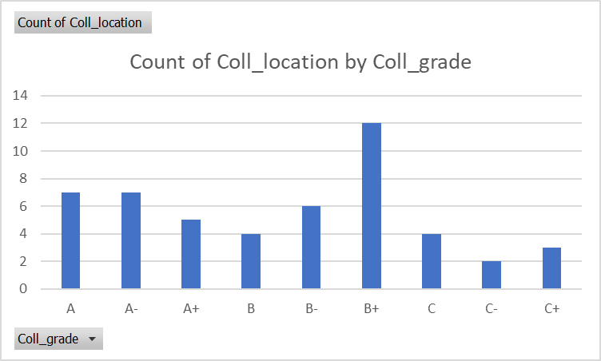
1. Retrieve the list of all colleges along with their grades and locations.
Query
SELECT Coll_name, Coll_grade, Coll_location FROM College;.

Slide 15
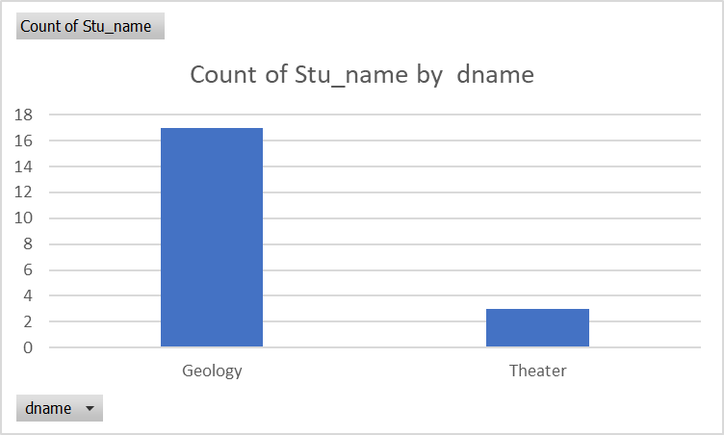
2. Display the name and email of all students in a specific department.
Join
Where
Query
SELECT Student1.Stu_ID, Student1.Stu_name, Student1.Stu_email, department1.dname
FROM Student1
JOIN department1 ON Student1.did = department1.did
WHERE department1.dname IN ('Geology', 'ComputerScience', 'Mathematics');
Back to Agenda

Slide 16
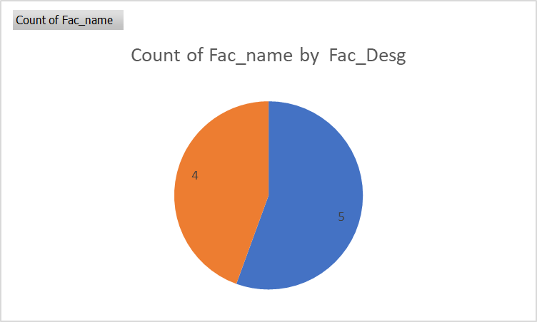
3. Get the list of all faculty members who have a specific designation in a particular department.
Query:
SELECT Fac_name, Fac_email, Fac_Desg FROM Faculty1
WHERE Fac_Desg in( 'Associate prof', 'Prof');

Slide 17
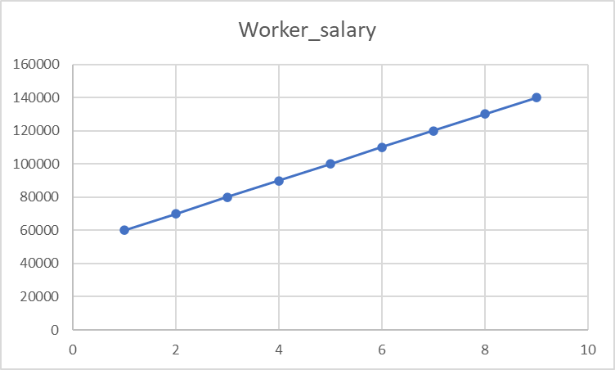
4. Get the list of all workers who earn a salary greater than a 5000.
Query
SELECT Worker_name, Worker_email, Worker_Phnu,Worker_salary FROM Worker1
WHERE Worker_salary > 50000;
Back to Agenda

Slide 18

5. Get the name, email, and phone number of all workers employed at a specific college.
Query
SELECT Worker_name, Worker_email, Worker_Phnu FROM Worker1
WHERE Coll_ID = 1;
Back to Agenda

Slide 19
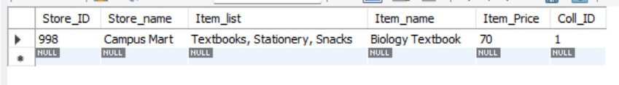
6. Retrieve the details of all items available at a particular campus store.
QUERY:
SELECT * FROM CAMPUS_STORE 1 WHERE STORE_ID = 998 ;
Back to Agenda

Slide 20
7. update the salary of the Worker in the "worker" table whose id is 176 by multiplying
their existing salary by 1.1
QUERY:
UPDATE WORKER 1
SET WORKER_SALARY = WORKER_SALARY * 1 . 1
WHERE WORKER_ID = 176 ;
Back to Agenda

Slide 21
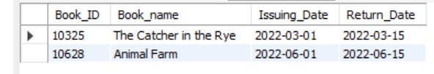
8. Show the list of all books issued by a specific student along with their issuing and return dates.
Query:
SELECT Book_ID, Book_name, Issuing_Date, Return_Date
FROM Library
WHERE Stu_ID = 2217 ;

Slide 22
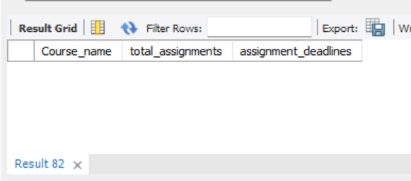
9. Show the total number of assignments and their respective deadlines for a specific course.
Query:
SELECT Course1.Course_name, COUNT(Assignment.Assignment_ID) AS total_assignments, GROUP_CONCAT(Assignment.Assignment_deadline SEPARATOR ', ') AS assignment_deadlines
FROM Course1
JOIN Assignment ON Course1.Course_ID = Assignment.Course_ID WHERE Course1.Course_ID = 110
GROUP BY Course1.Course_name;

Slide 23
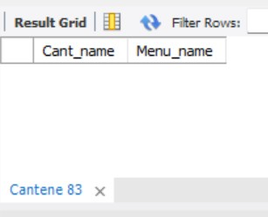


10. Show the menu of a specific canteen along with its name.
Query:
SELECT Cant_name, Menu_name FROM Cantene WHERE Cant_ID = 1097;

Slide 24


Thank You

